Slide 1
Creativity: A Quick Introduction

Slide 2
Creativity – nature or nurture?
What is your definition of creativity?
Tends to be this idea that creativity is an innate talent seen in primarily artists…do you agree?
The reality is much different, with many now identifying creativity as a skill one can learn and develop
Malcolm Gladwell’s 2008 book Outliers: 10,000 hours
Do you think this concept is accurate, and if so, does it apply to everything?
A 2014 study examined this idea in detail…found that practice is not as important in certain areas.

Slide 3
Creativity as a formula for success
Dr. Ruth Noller, who helped develop creative problem solving, proposed a creativity (C) formula:
C = f_{a}(K,I,E)
Where a is attitude, K is knowledge, I is imagination, and E is evaluation
Attitude then, has its own formula:
f_{a} = V,DP,IM
Where V is vision, DP is deliberate practice, and IM is intrinsic motivation

Slide 4
Creative Problem Solving (CPS)
Four stages to the CPS process:
Clarification
Ideate
Develop
Implement
Link to Scientific Method?

Slide 5
Clarification
Clarification involves the preliminary steps of identifying what the true nature of the problem being examined is
It includes collecting as much data on the problem/issue as possible
It also focuses on emphasizing what the primary goals and objectives are
The end result of clarification is hopefully a very clear, precise question to address in the next stage
Questions usually begin with something like ‘How might I…’

Slide 6
Ideate
This stage involves the generation of ideas that could help solve the problem or issue
Ideation has two key phases:
Divergent thinking
Convergent thinking
The idea behind these two phases is to create as many ideas as possible initially, then systematically evaluate and narrow them down
Most popular ideate tool is brainstorming

Slide 7
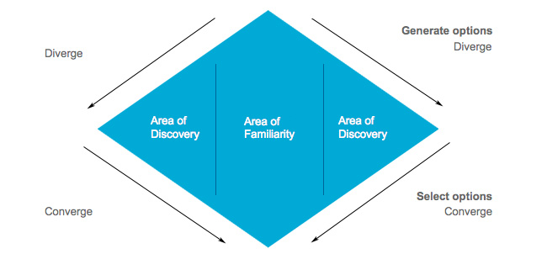
From: Puccio, Murdock, and Mance (2005).

Slide 8
Divergent Thinking
Four key guidelines when creating ideas in the divergent stage:
Defer Judgement
Go for Quantity
Seek Novelty
Make connections – build upon other ideas
A useful tool to help produce novelty is forced connections

Slide 9
Convergent Thinking
Four key guidelines when narrowing down your ideas in the convergent stage:
Use affirmative judgement
Keep novelty alive
Be deliberate, stay focused
Check your objectives

Slide 10
Development
Once the ideate stage has provided some ideas, the third stage is to evaluate those ideas further
The end goal of the development stage is to find one or two ideas that would provide a valid solution to the problem
A great tool to accomplish this evaluation is POINT:
Pluses
Opportunities for future pluses
Issues
New Thinking to overcome issues

Slide 11
Implementation
The final stage of the CPS process is to put the fully-developed idea into action
Important elements to consider at this stage are the stakeholders involved, namely who may assist with the implementation process but also who may resist
An action plan can sometimes resemble a ‘to do’ list, and assigning individuals or teams to the specific tasks provides greater accountability

Slide 12
Creativity Exercise
In small groups, come up with an idea for a theoretical machine that currently doesn’t exist that ‘solves a problem’.
Then using the modelling clay provided, create a model for a prototype of your machine.
Come up with a description of how it works.
Think about the four stages of CPS…
Your first step will be to determine your problem, Clarification
Be prepared to share your machine with the class.

